Slide 1
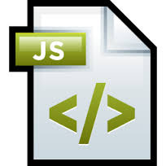
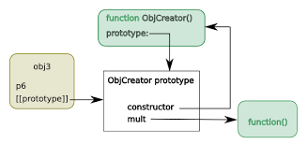
Java Script objects and Prototypes

Slide 2
Object Creation and Modification
JavaScript is an object-based language. Everything is an object in JavaScript.
JavaScript is template based not class based. Here, we don't create class to get the object. But, we direct create objects.
In JavaScript, an object is an unordered collection of key-value pairs. Each key-value pair is called a property.
An object can be created with figure brackets {…} with an optional list of properties. A property is a “key: value” pair, where a key is a string (also called a “property name”), and value can be anything.
Properties of an object are accessed using a dot notation: object.property
Properties are not variables, so they are not declared
The new expression is used to create an object
This includes a call to a constructor
The new operator creates a blank object, the constructor creates and initializes all properties of the object
Object creation
var person = {
firstName: ‘Ram',
lastName: ‘Mohan'
};
console.log(person.firstName);
console.log(person.lastName);
{ firstName: ‘Ram', lastName: ‘Mohan' }
Modifying the value of a property
let person = {
firstName: ‘Ram',
lastName: ‘Mohan'
};
person.lastName = ‘Kumar';
console.log(person);
{ firstName: ‘Ram', lastName: ‘Kumar' }

Slide 3


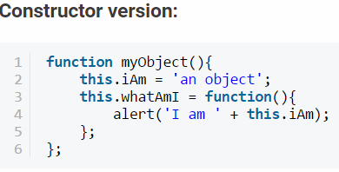
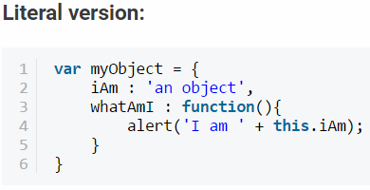


Object creation
There are two ways to create a JavaScript object:
Constructor functions
Literal notation
Defining Methods and Properties
Simply use it by referencing its variable name
Need to instantiate (create a new instance of) the object first;

Slide 4
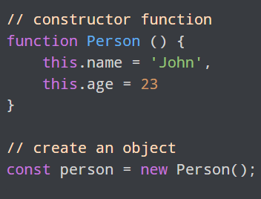
Functions as constructors
In JavaScript, any function can be used as a constructor!
by convention, constructors' names begin in uppercase
when a function is called with new, it implicitly returns this
all global "classes" (Number, String, etc.) are functions acting as constructors, that contain useful properties.
In the above example, function Person() is an object constructor function.
To create an object from a constructor function, we use the new keyword.

Slide 5
Instantiating an Object: The new Operator
The new keyword performs following four tasks:
It creates new empty object e.g. obj = { };
It sets new empty object's invisible 'prototype' property to be the constructor function's visible and accessible 'prototype' property. (Every function has visible 'prototype' property whereas every object includes invisible 'prototype' property)
It binds property or function which is declared with this keyword to the new object.
It returns newly created object unless the constructor function returns a non-primitive value (custom JavaScript object). If constructor function does not include return statement then compiler will insert 'return this;' implicitly at the end of the function. If the constructor function returns a primitive value then it will be ignored.

Slide 6
this Member
Every time you create a new class, there is a member automatically created for it. This member is called this and it represents the class itself. Furthermore, the this member has direct access to all properties of its parent class.
Using this in a constructor, you can create a list of the properties of the class. To do this, type this, followed by the period operator, followed by the name of the new property you want to create. To complete the creation of the property, you can assign it to an argument passed in the parentheses.
In JavaScript, this keyword when used with the object's method refers to the object. this is bound to an object.

Slide 7
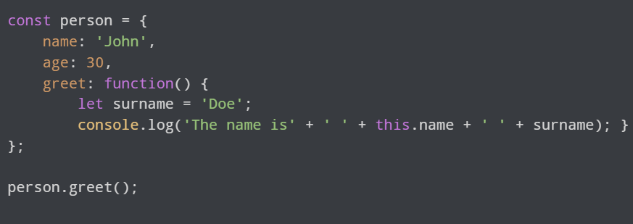
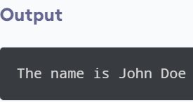
Example:
The function inside of an object can access it's variable in a similar way as a normal function would. For example

Slide 8
Methods
While the properties are used to describe or characterize an object, some objects may be able to perform actions. This action also is referred to as a method.
Creating a Method
A method of a class is created like a function. Since a function cannot be created inside of another function, in this case inside of the class' constructor, when defining the function, you can indicate that it belongs to the class with the use of the this object and the access to the defined member(s) of the class.
After creating the method, to add it to your class, assign it to the desired member name using the this object in the constructor of the class as we did previously.

Slide 9
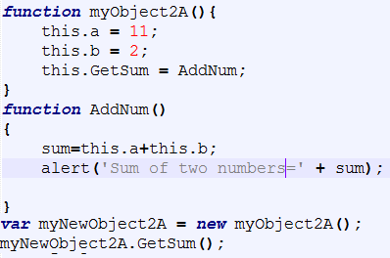
Example: adding of two numbers

Slide 10
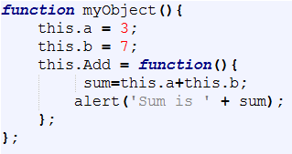
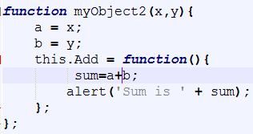


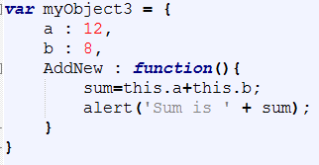
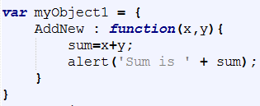
Adding of two numbers-constructor version
Passing without parameters | Passing with parameters
Adding of two numbers-Literal version

Slide 11
Differences:
The constructor object has its properties and methods defined with the keyword 'this' in front of it, whereas the literal version does not.
In the constructor object the properties/methods have their 'values' defined after an equal sign '=' whereas in the literal version, they are defined after a colon ':'.
The constructor function can have (optional) semi-colons ';' at the end of each property/method declaration whereas in the literal version if you have more than one property or method, they MUST be separated with a comma ',' and they CANNOT have semi-colons after them, otherwise JavaScript will return an error.

Slide 12
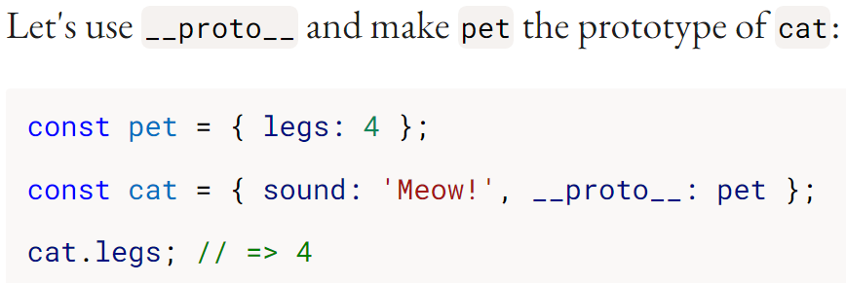
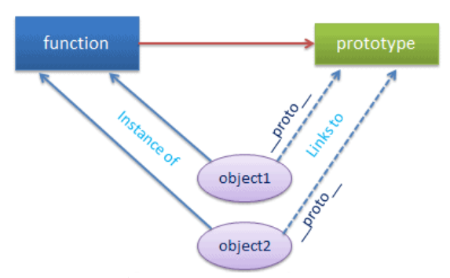
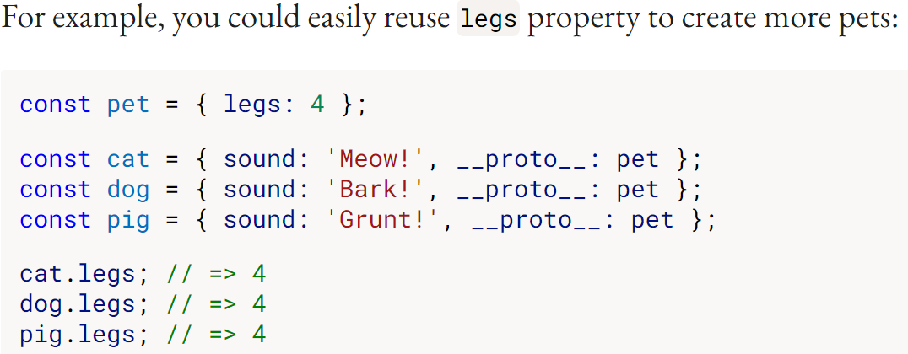
JavaScript Prototype
Every JavaScript function has a prototype property (this property is empty by default), and you attach properties and methods on this prototype property when you want to implement inheritance.
The prototype property is used primarily for inheritance; you add methods and properties on a function’s prototype property to make those methods and properties available to instances of that function.
Every object which is created using literal syntax or constructor syntax with the new keyword, includes __proto__ property that points to prototype object of a function that created this object.
Note: __proto__ is deprecated, In production code Object.create() is recommended.

Slide 13
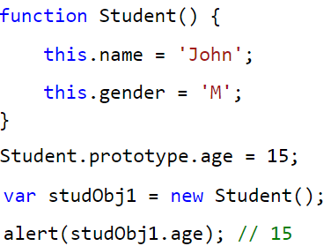
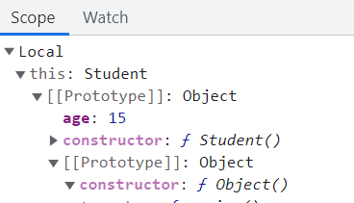

Functions and prototypes
The prototype is an object that is associated with every functions and objects by default in JavaScript, where function's prototype property is accessible and modifiable and object's prototype property (aka attribute) is not visible.
The prototype object is special type of enumerable object to which additional properties can be attached to it which will be shared across all the instances of it's constructor function.
So, use prototype property of a function in the above example in order to have age properties across all the objects as shown below.

Slide 14
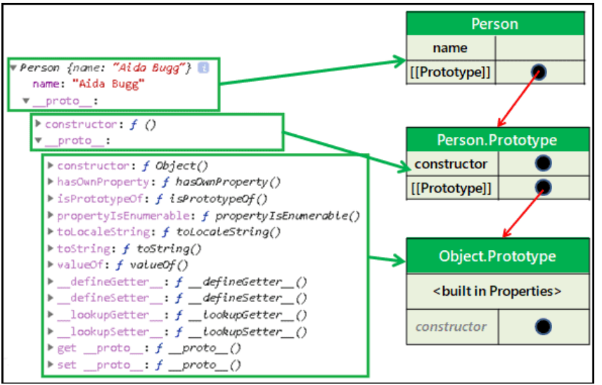
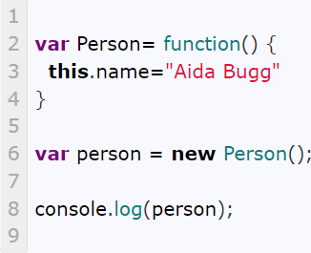
Prototype chain
An Object has a prototype. A prototype is also an object. Hence Even it may have its own prototype object. This is referred to as prototype chain.
The following example creates a person object from the Person constructor function. In such a case the <functionName>.prototype i.e. Person.prototype becomes the Prototype of the newly created person object.

Slide 15
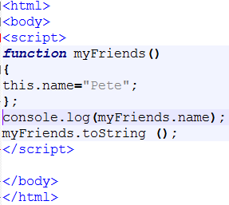
This example demonstrates the prototype chain of an object’s prototype:
To find the name property, the search will begin directly on the myFriends object and will immediately find the name property because we defined the property name on the myFriend object. This could be thought of as a prototype chain with one link.
In this example, the search for the toString() method will also begin on the myFriends’ object, but because we never created a toString method on the myFriends object, the compiler will then search for it on the myFriends prototype (the object which it inherited its properties from).​​
And since all objects created with the object literal inherits from Object.prototype, the toString method will be found on Object.prototype​​

Slide 16
Why is Prototype Important and When it is Used?
Prototype is important in JavaScript because JavaScript does not have classical inheritance based on Classes and therefore all inheritance in JavaScript is made possible through the prototype property. JavaScript has a prototype-based inheritance mechanism.
Prototype is also important for accessing properties and methods of objects. The prototype attribute (or prototype object) of any object is the “parent” object where the inherited properties were originally defined.

Slide 17
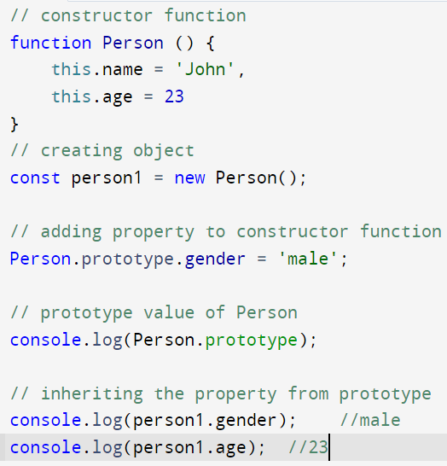
Prototype Inheritance
A prototype can be used to add properties and methods to a constructor function. And objects inherit properties and methods from a prototype.
The object person1 and person2 inherits the property gender from the prototype property of Person constructor function

Slide 18
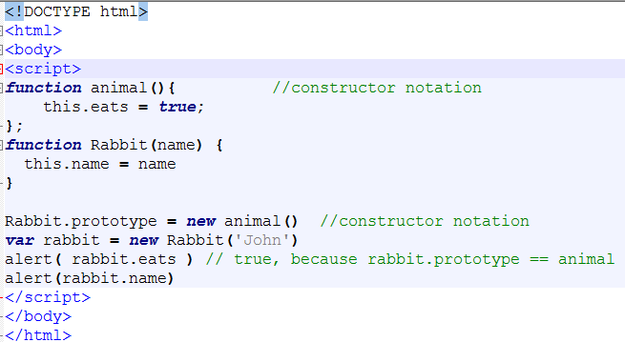
Example-1

Slide 19
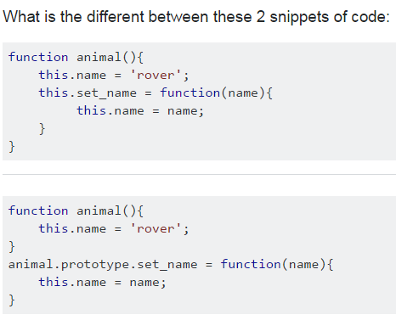
Why prototype?
The set_name function is created each and every time you create an animal.
In the first example, each separate animal has an own property for the set_name function, while in the second example they share the same function via their prototype.
The advantage of the first version is that the methods can access local (private) variables declared inside the constructor.
The advantage of the second method is that it needs less memory (since you only store the method once instead of a many times) and is more performative in current JS engines.
Using the second method you can also modify or add methods to a class in a way that also affects instances that were already created.
The function does not have to be re-created each time; it exists in one place in the prototype. So when you call someAnimal.set_name("Ubu");
The ’this’ context will be set to someAnimal and set_name function will be called.
Using the prototype makes for faster object creation, since that function does not have to be re-created each time a new object is created.

Slide 20
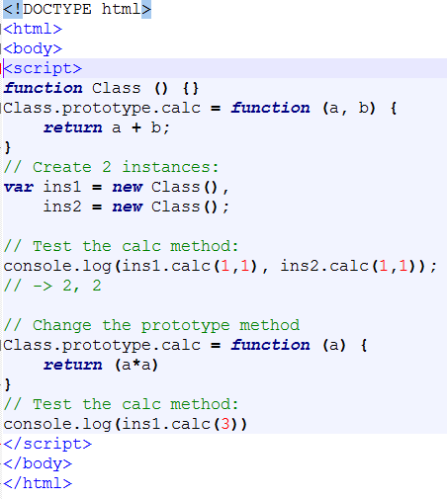
Change the prototype method

Slide 21
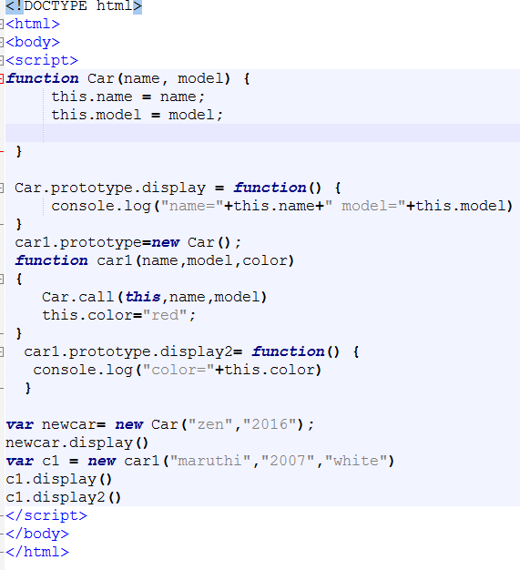
Multiple Levels of Inheritance

Slide 22
Conclusion
Objects are an extremely useful and versatile feature of the JavaScript programming language. They are some of the main building blocks of writing code in JavaScript, and are a practical way to organize related data and functionality. To-do lists, shopping carts, user accounts, and locations on a webmap are all a few of the many examples of real-world JavaScript objects that you might encounter.
JavaScript is the most common of the prototype-capable languages, and its capabilities are relatively unique. When used appropriately, prototypical inheritance in JavaScript is a powerful tool that can save hours of coding.
Prototypes and prototypical inheritance are commonly used in many web application frameworks, such as AngularJS, to allow sharing of common behavior and state among similar components.

Slide 23
Exercises
Write a JavaScript program to delete the rollno property from the following object. Also print the object before or after deleting the property.
var student = { name : “Ram Mohan", Sem : "VI", rollno : 62 };
Write a js program using prototype to calculate square,cube and square root of a number
Write a js program using prototype to calculate area, and circumference of rectangle, square.
Write a js program using prototype to implement a calculator.

